Slide 1
Simple Linear Regression
By
Amara Dinesh Kumar

Slide 2
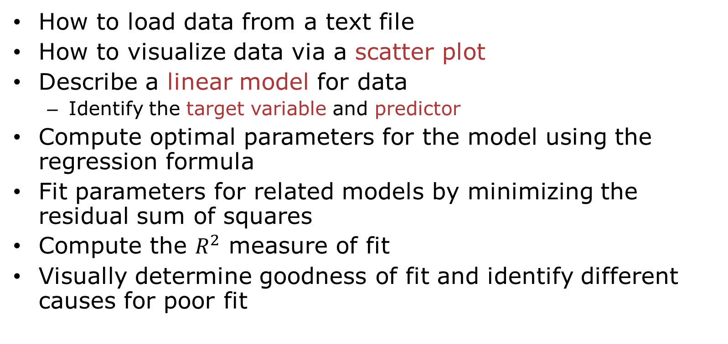
Learning Objectives
How to load data from a text file
How to visualize data via a scatter plot
Describe a linear model for data
Identify the target variable and predictor
Compute optimal parameters for the model using the regression formula
Fit parameters for related models by minimizing the residual sum of squares
Compute the $R^{2}$ measure of fit
Visually determine goodness of fit and identify different causes for poor fit

Slide 3
Outline
Motivating Example: Predicting the mpg of a car
Linear Model
Least Squares Fit Problem
Sample Mean and Variance
LS Fit Solution
Assessing Goodness of Fit

Slide 4
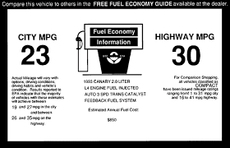
Example: What Determines mpg in a Car?
What engine characteristics determine fuel efficiency?
Why would a data scientist be hired to answer this question?
Not to help purchasing a specific car.
The mpg for a currently available car is already known.
(If the car company isn’t lying?)
To guide building new cars.
Understand what is reasonably achievable before full design
To find cars that are outside the trend.
Example: What cars give great mpg for the cost or size?

Slide 5
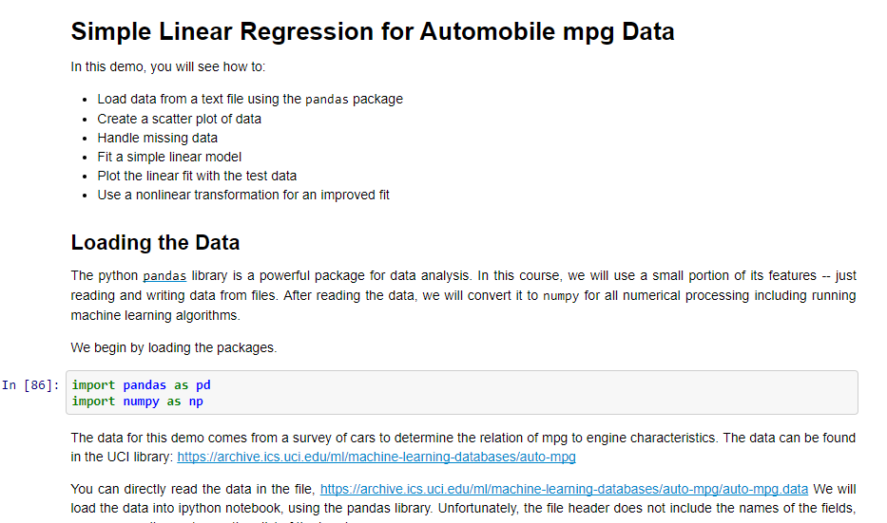
Demo

Slide 6
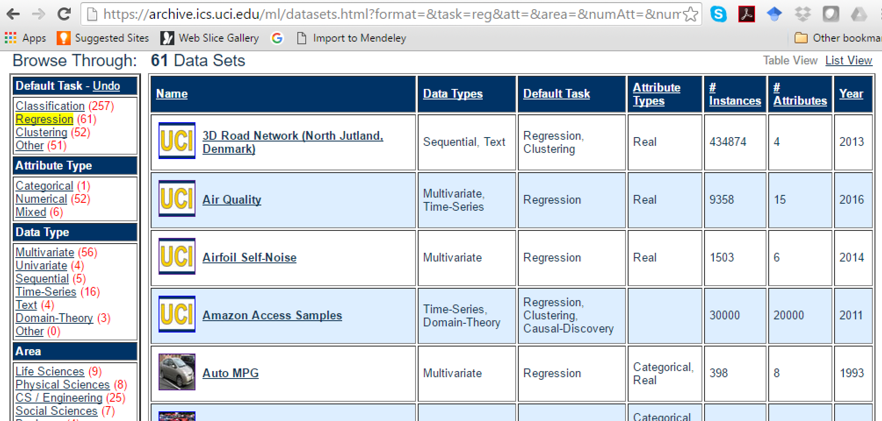
Getting Data
Data from UCI dataset library: https://archive.ics.uci.edu/ml/datasets.html

Slide 7


Python Packages
Python has many powerful packages
This demo uses three key packages
Pandas:
Used for reading and writing data files
Loads data into dataframes
Numpy
Numerical operations including linear algebra
Data is stored in ndarray structure
We convert from dataframes to ndarray
Matplotlib:
MATLAB-like plotting and visualization

Slide 8
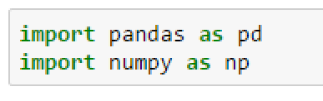
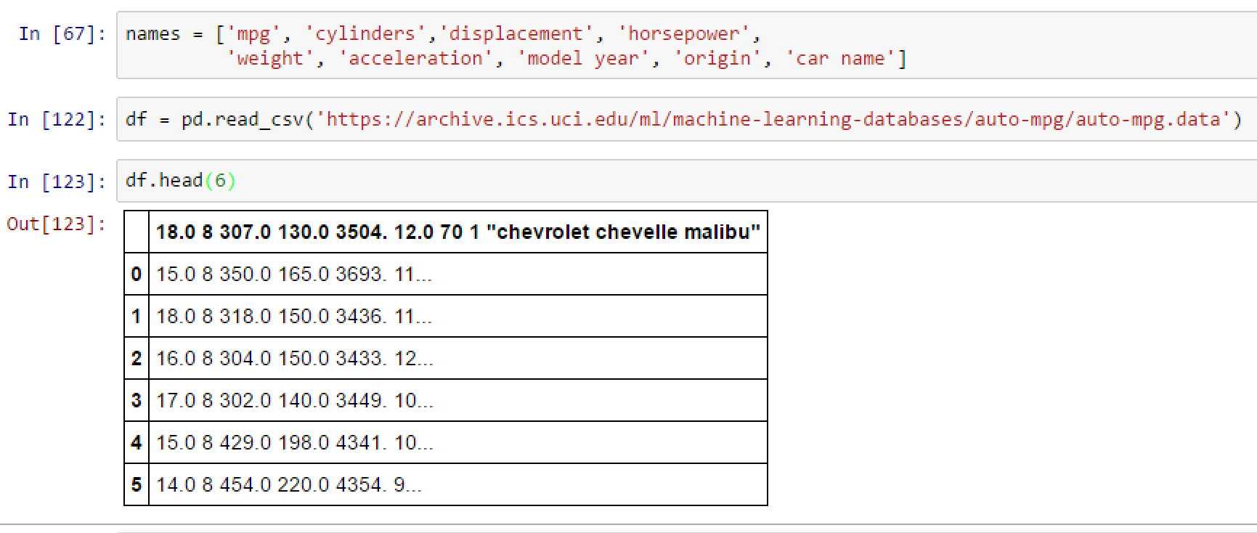
Loading the Data in Jupyter Notebook Try 1: The Wrong Way!
Python pandas library
Read_csv command.
Read URL or file location.
Creates a dataframe object
http://pandas.pydata.org/pandas-docs/stable/dsintro.html#dataframe
Problems
Does not parse columns
All data in a single column
Read_csv assumes columns are delimited by commas
Mistakes first line as header

Slide 9
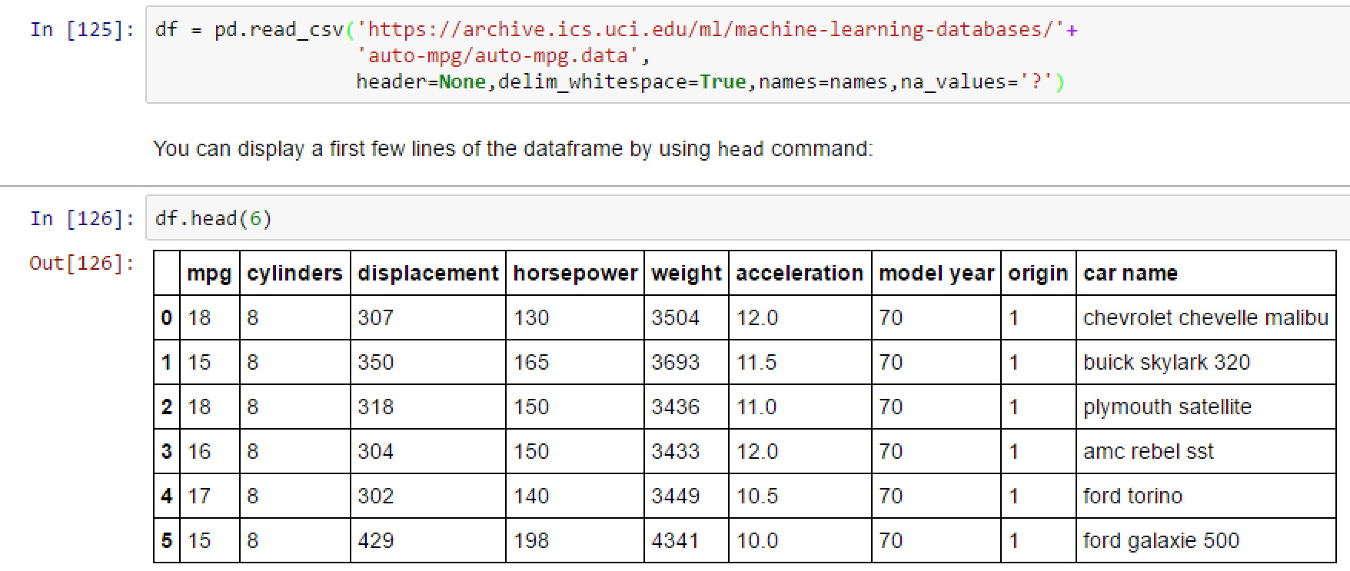
Loading the Data in Jupyter Try 2: Fixing the Errors
Fix the arguments in read_csv
Pandas routines have many options
When you get a problem:
Google is your friend!
You are not the first to have these problems.
Ex: google “pandas.dataframe”
Ex. google “pandas.read”
Dataframe has three components
df.columns, df.index, df.values

Slide 10
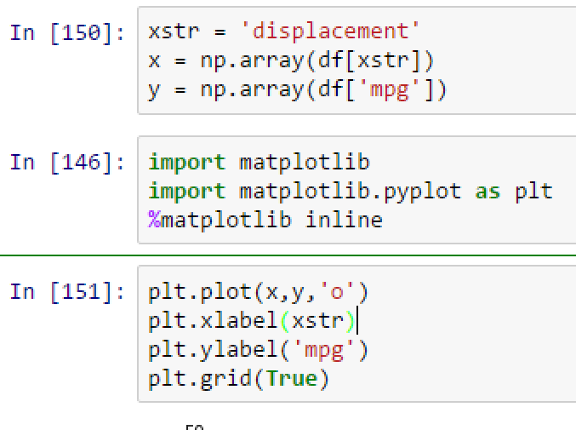
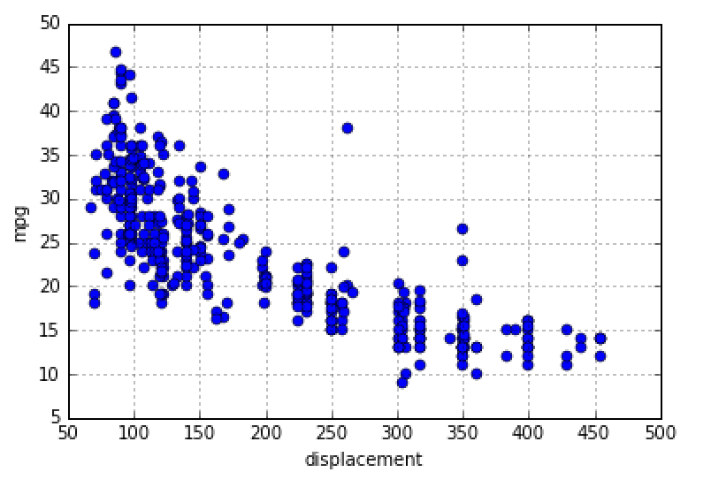
Visualizing the Data
When possible, look at data before doing anything
Python has MATLAB-like plotting
Matplotlib module

Slide 11
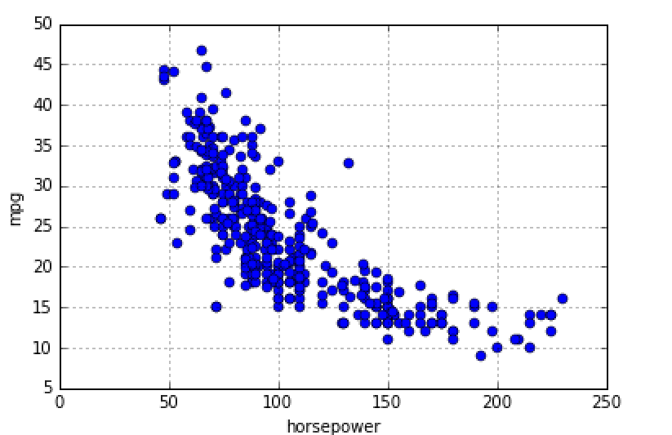
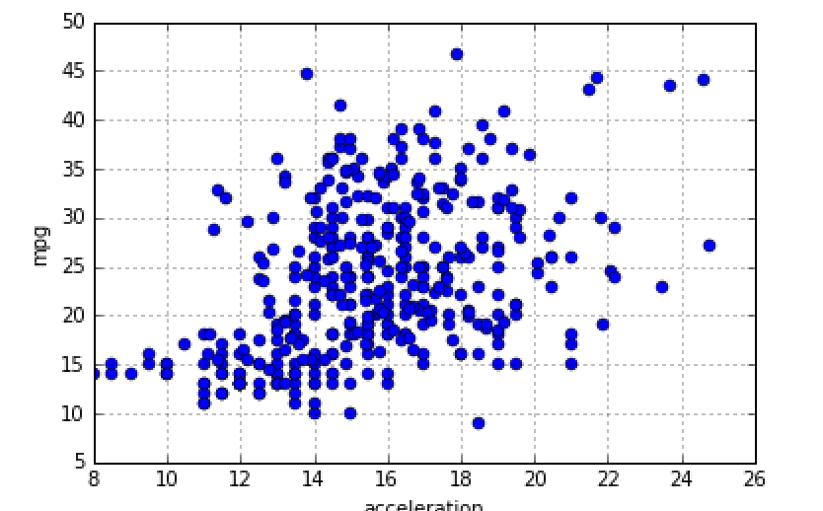
Exercise: Postulate a Model
Break into small groups
Try to find a mathematical to predict mpg from displacement, horsepower or acceleration
Make a reasonable / eyeball guess. No need for program now.
What does your model predict when displacement = 200?
Is the prediction reasonable? Can you improve your model?
mpg
Displacement
Horsepower
Acceleration

Slide 12
Outline
Motivating Example: Predicting the mpg of a car
Linear Model
Least Squares Fit Problem
Sample Mean and Variance
LS Fit Solution
Assessing Goodness of Fit

Slide 13
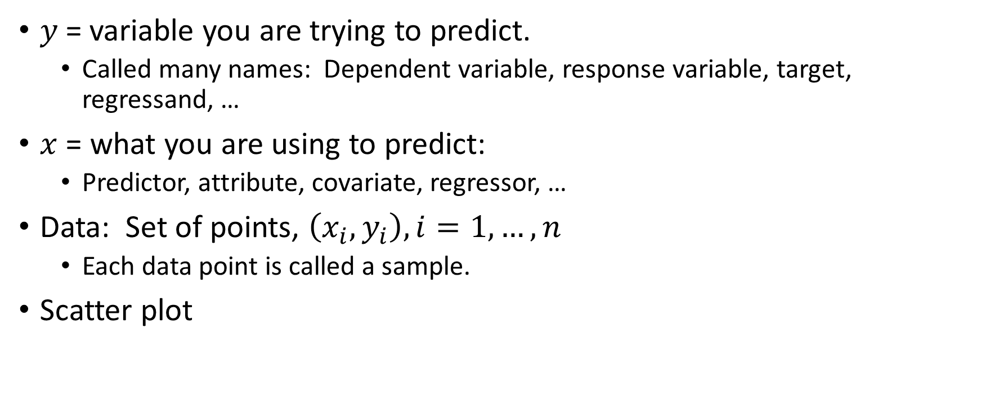


Data
$y$= variable you are trying to predict.
Called many names: Dependent variable, response variable, target, regressand, …
$x$ = what you are using to predict:
Predictor, attribute, covariate, regressor, …
Data: Set of points, $\left(x_{i},y_{i}\right), i=1,…, n$
Each data point is called a sample.
Scatter plot
$y$ = mpg
$x$ = horsepower

Slide 14
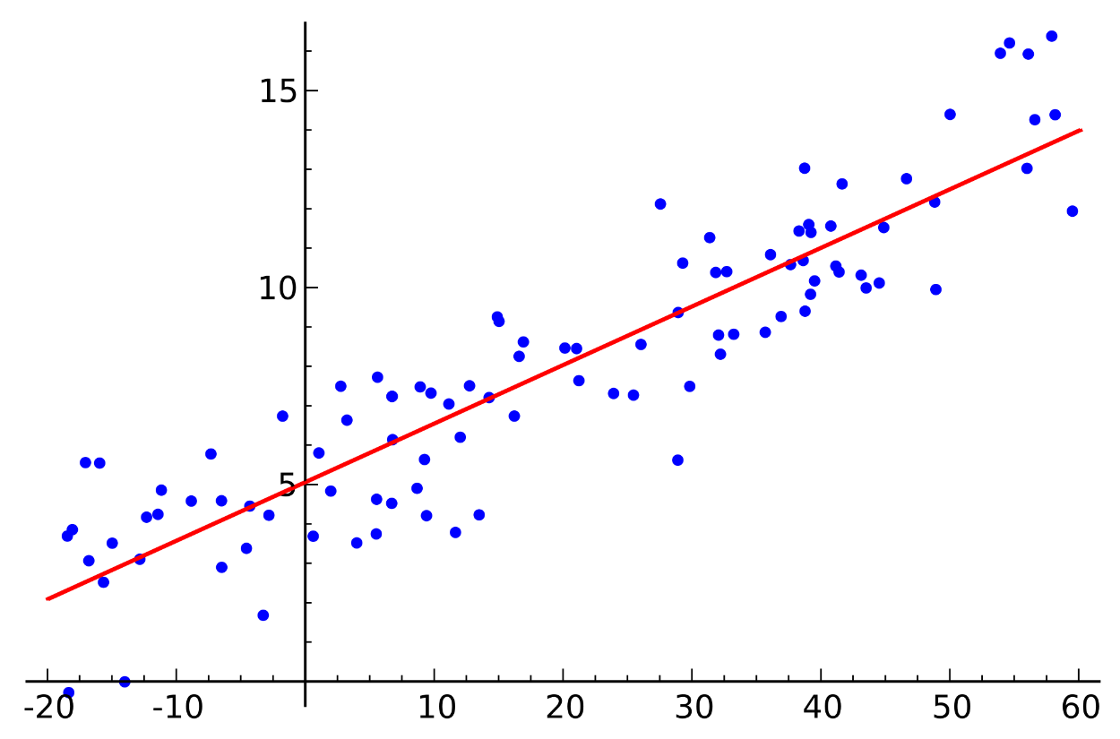
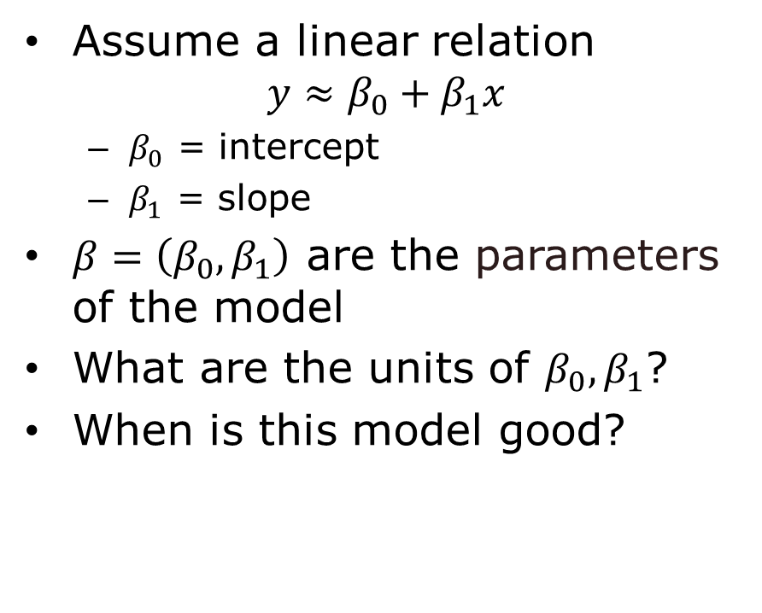
Linear Model
Assume a linear relation $y≈β_{0}+β_{1}x$
$β_{0}$ = intercept
$β_{1}$ = slope
$β=\left(β_{0},β_{1}\right)$ are the parameters of the model
What are the units of $β_{0},β_{1}$?
When is this model good?
Regression line

Slide 15
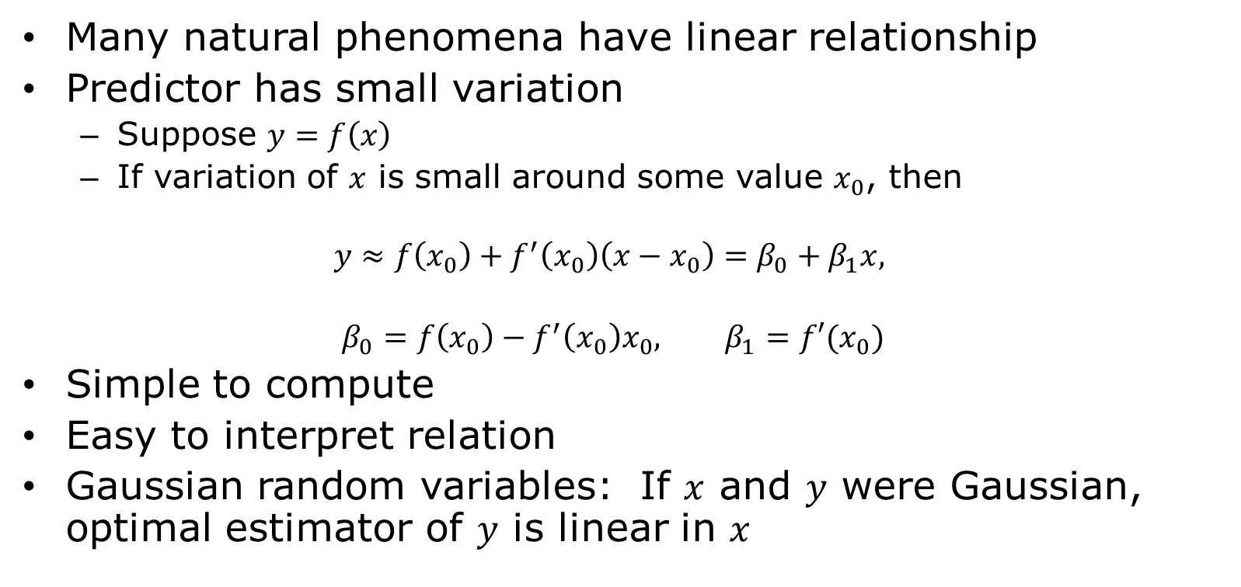
Why Use a Linear Model?
Many natural phenomena have linear relationship
Predictor has small variation
Suppose $y=f\left(x\right)$
If variation of $x$ is small around some value $x_{0}$, then
$$y≈f\left(x_{0}\right)+f^{′}\left(x_{0}\right)\left(x−x_{0}\right)=β_{0}+β_{1}x,$$
$$β_{0}=f\left(x_{0}\right)−f^{′}\left(x_{0}\right)x_{0}, β_{1}=f′(x_{0})$$
Simple to compute
Easy to interpret relation
Gaussian random variables: If $x$ and $y$ were Gaussian, optimal estimator of $y$ is linear in $x$

Slide 16
Outline
Motivating Example: Predicting the mpg of a car
Linear Model
Least Squares Fit Problem
Sample Mean and Variance
LS Fit Solution
Assessing Goodness of Fit

Slide 17

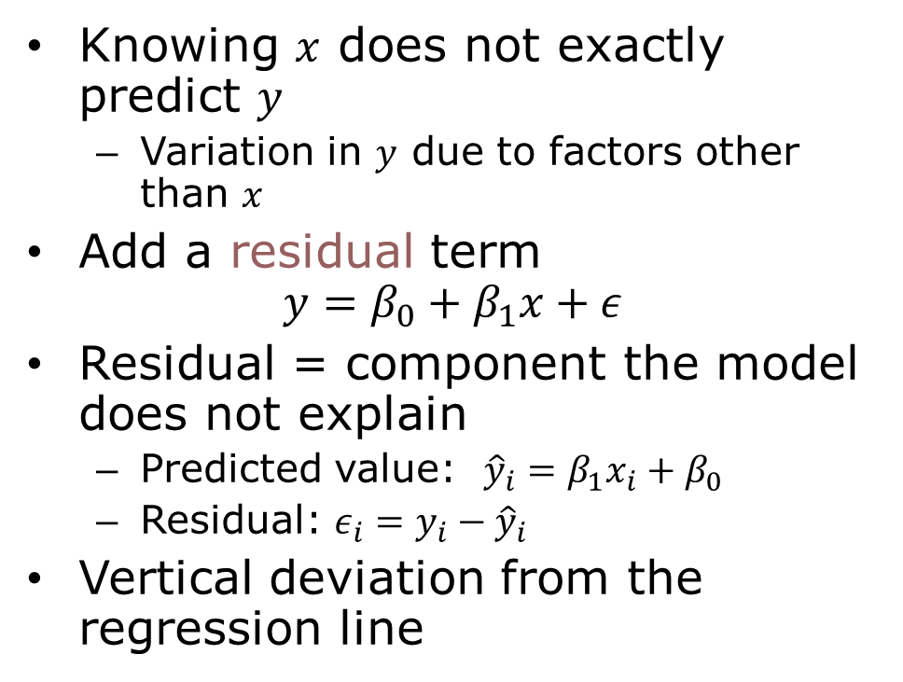
Linear Model Residual
Knowing $x$ does not exactly predict $y$
Variation in $y$ due to factors other than $x$
Add a residual term $y=β_{0}+β_{1}x+ε$
Residual = component the model does not explain
Predicted value: ${\hat{y}}_{i}=β_{1}x_{i}+β_{0}$
Residual: $ε_{i}=y_{i}−{\hat{y}}_{i}$
Vertical deviation from the regression line

Slide 18
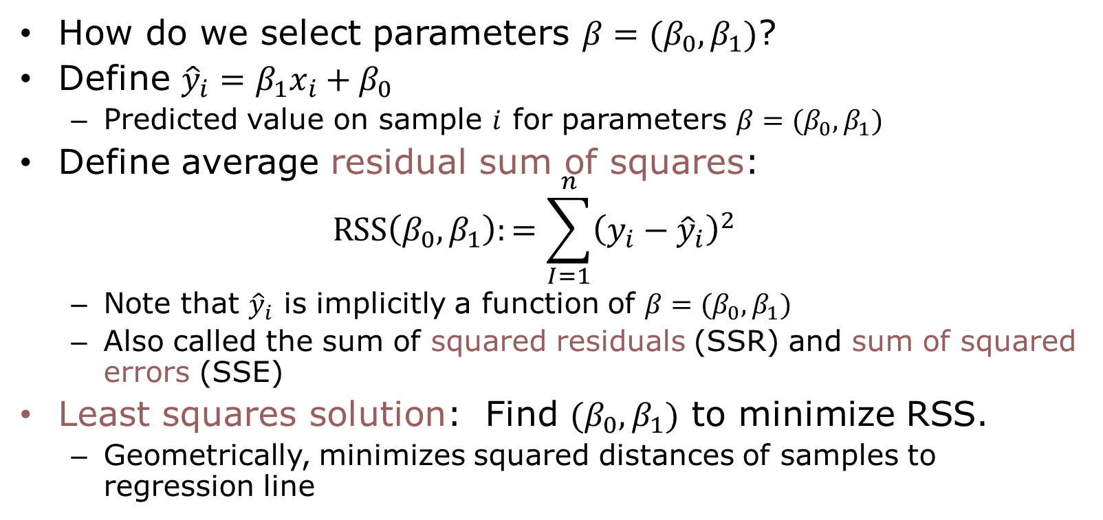
Least Squares Model Fitting
How do we select parameters $β=(β_{0},β_{1})$?
Define ${\hat{y}}_{i}=β_{1}x_{i}+β_{0}$
Predicted value on sample $i$ for parameters $β=(β_{0},β_{1})$
Define average residual sum of squares: $RSS\left(β_{0},β_{1}\right):=\sum_{I=1}^{n}{{\left(y_{i}−{\hat{y}}_{i}\right)}^{2}}$
Note that ${\hat{y}}_{i}$ is implicitly a function of $β=(β_{0},β_{1})$
Also called the sum of squared residuals (SSR) and sum of squared errors (SSE)
Least squares solution: Find $(β_{0},β_{1})$ to minimize RSS.
Geometrically, minimizes squared distances of samples to regression line

Slide 19
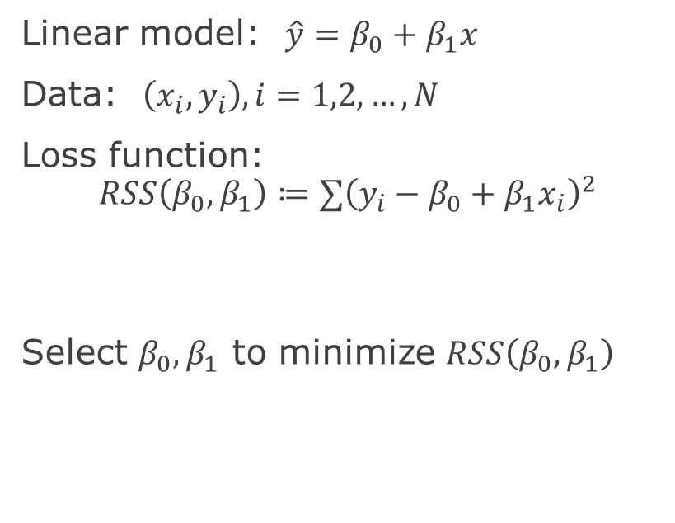
Finding Parameters via Optimization A general ML recipe
General ML problem
Simple linear regression
Find a model with parameters
Get data
Pick a loss function
Measures goodness of fit model to data
Function of the parameters
Find parameters that minimizes loss
Linear model: $\hat{y}=β_{0}+β_{1}x$
Data: $\left(x_{i},y_{i}\right),i=1,2,…,N$
Loss function: $$RSS\left(β_{0},β_{1}\right)≔∑{\left(y_{i}−β_{0}+β_{1}x_{i}\right)}^{2}$$
Select $β_{0},β_{1}$ to minimize $RSS\left(β_{0},β_{1}\right)$

Slide 20
Outline
Motivating Example: Predicting the mpg of a car
Linear Model
Least Squares Fit Problem
Sample Mean and Variance
LS Fit Solution
Assessing Goodness of Fit

Slide 21
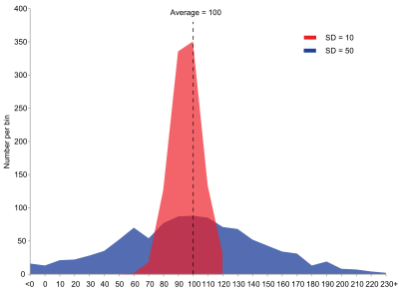
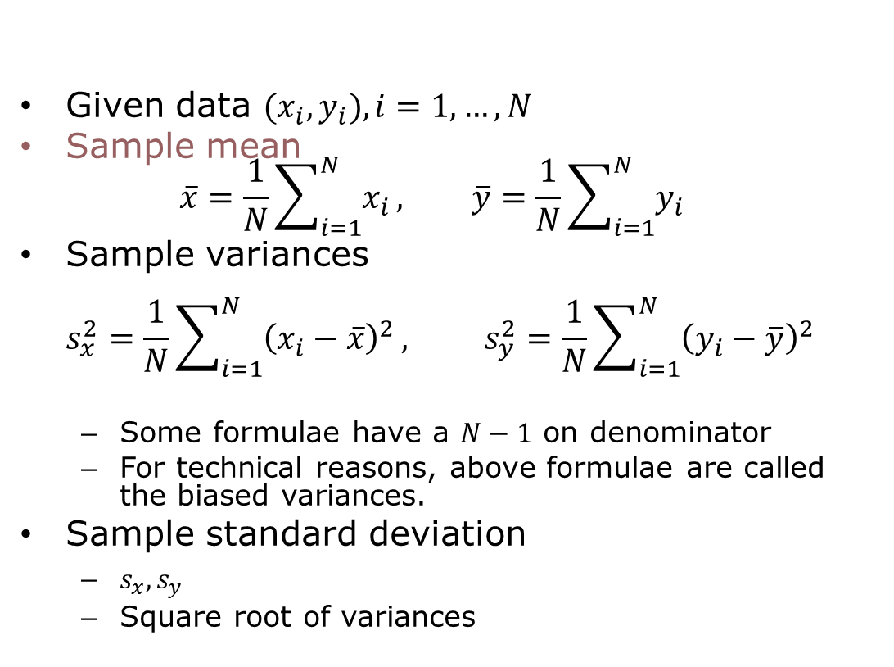
Sample Mean and Standard Deviations
Given data ${(x}_{i},y_{i}), i=1,…,N$
Sample mean $\overline{x}=\frac{1}{N}\sum_{i=1}^{N}{x_{i}}, \overline{y}=\frac{1}{N}\sum_{i=1}^{N}{y_{i}}$
Sample variances $s_{x}^{2}=\frac{1}{N}\sum_{i=1}^{N}{{\left(x_{i}−\overline{x}\right)}^{2}}, s_{y}^{2}=\frac{1}{N}\sum_{i=1}^{N}{{\left(y_{i}−\overline{y}\right)}^{2}}$
Some formulae have a $N−1$ on denominator
For technical reasons, above formulae are called the biased variances.
Sample standard deviation
$s_{x}, s_{y}$
Square root of variances
Visualizing standard deviation
https://en.wikipedia.org/wiki/Standard_deviation

Slide 22
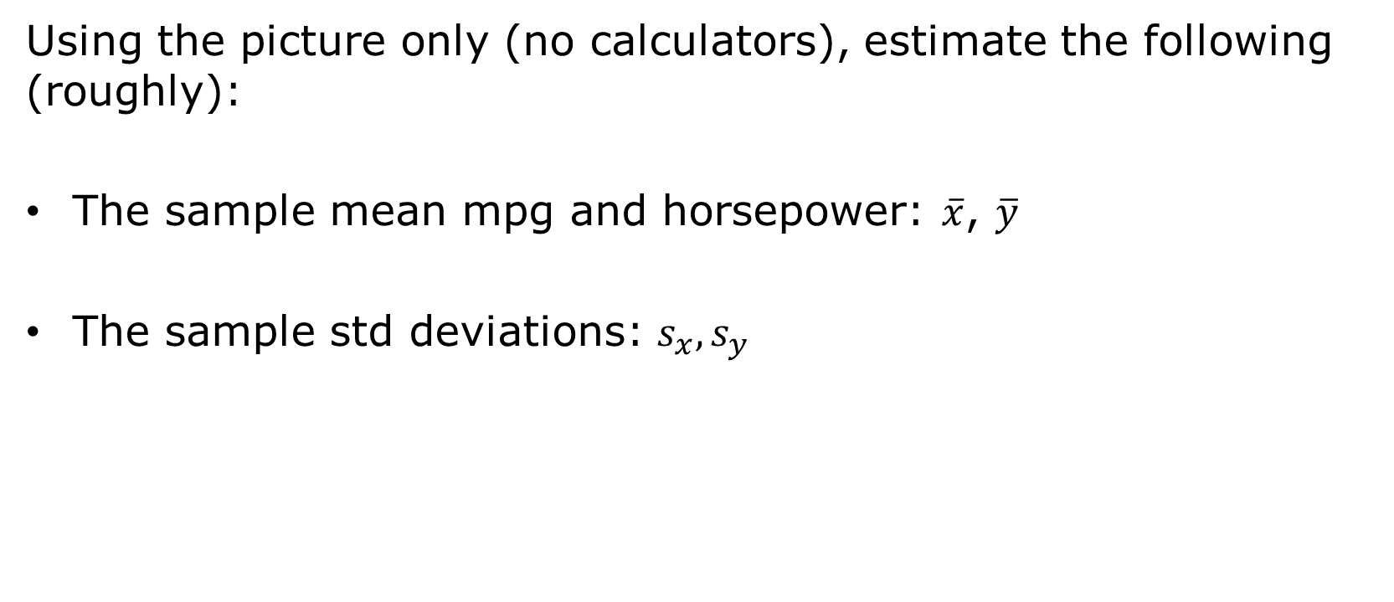
Visualizing Mean and SD on Scatter Plot Question
Using the picture only (no calculators), estimate the following (roughly):
The sample mean mpg and horsepower: $\overline{x}$, $\overline{y}$
The sample std deviations: $s_{x}, s_{y}$

Slide 23

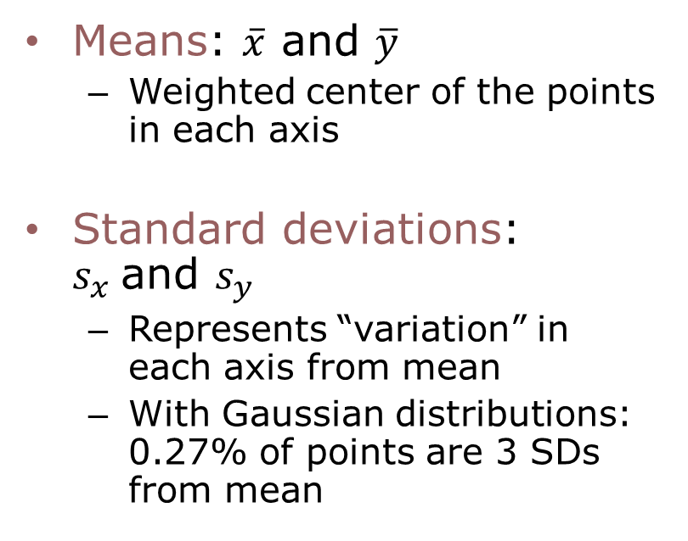



Visualizing Mean and SD on Scatter Plot Approximate answer
Means: $\overline{x}$ and $\overline{y}$
Weighted center of the points in each axis
Standard deviations: $s_{x}$and $s_{y}$
Represents “variation” in each axis from mean
With Gaussian distributions: 0.27% of points are 3 SDs from mean
$$±s_{y}$$
$$\overline{y}$$
$$\overline{x}$$
$$±s_{x}$$

Slide 24
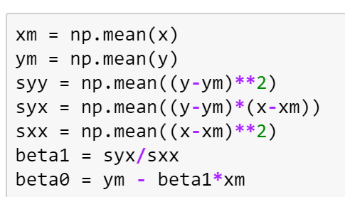

Computing Means and SD in Python
Exact answer can be computed in python
$$±s_{y}$$
$$\overline{y}$$
$$\overline{x}$$
$$±s_{x}$$

Slide 25
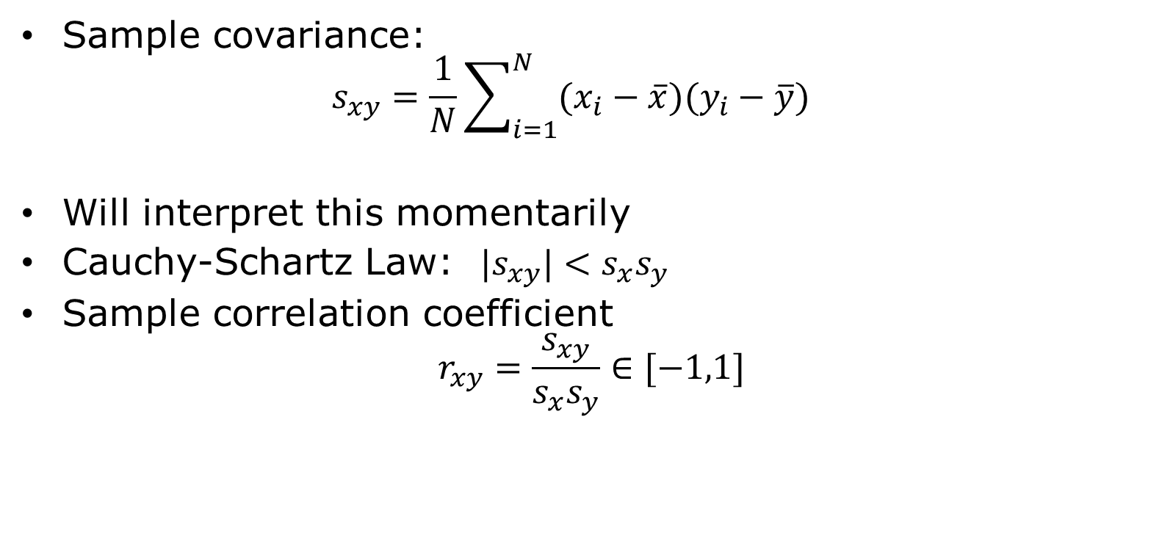
Sample Covariance
Sample covariance: $s_{xy}=\frac{1}{N}\sum_{i=1}^{N}{(x_{i}−\overline{x})(y_{i}−\overline{y})}$
Will interpret this momentarily
Cauchy-Schartz Law: ${|s}_{xy}|<s_{x}s_{y}$
Sample correlation coefficient $r_{xy}=\frac{s_{xy}}{s_{x}s_{y}}∈[−1,1]$

Slide 26
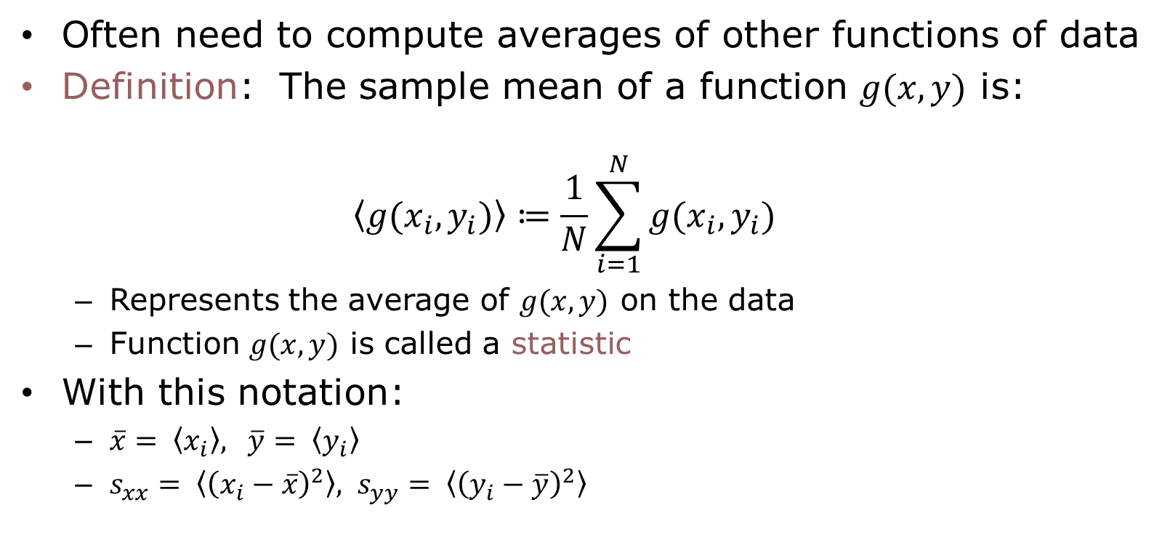
Statistics
Often need to compute averages of other functions of data
Definition: The sample mean of a function $g(x,y)$ is: $\left\langle g(x_{i},y_{i})\right\rangle ≔\frac{1}{N}\sum_{i=1}^{N}{g(x_{i},y_{i})}$
Represents the average of $g(x,y)$ on the data
Function $g(x,y)$ is called a statistic
With this notation:
$\overline{x}= \left\langle x_{i}\right\rangle , \overline{y}= \left\langle y_{i}\right\rangle$
$s_{xx}= \left\langle {\left(x_{i}−\overline{x}\right)}^{2}\right\rangle , s_{yy}= \left\langle {\left(y_{i}−\overline{y}\right)}^{2}\right\rangle$

Slide 27
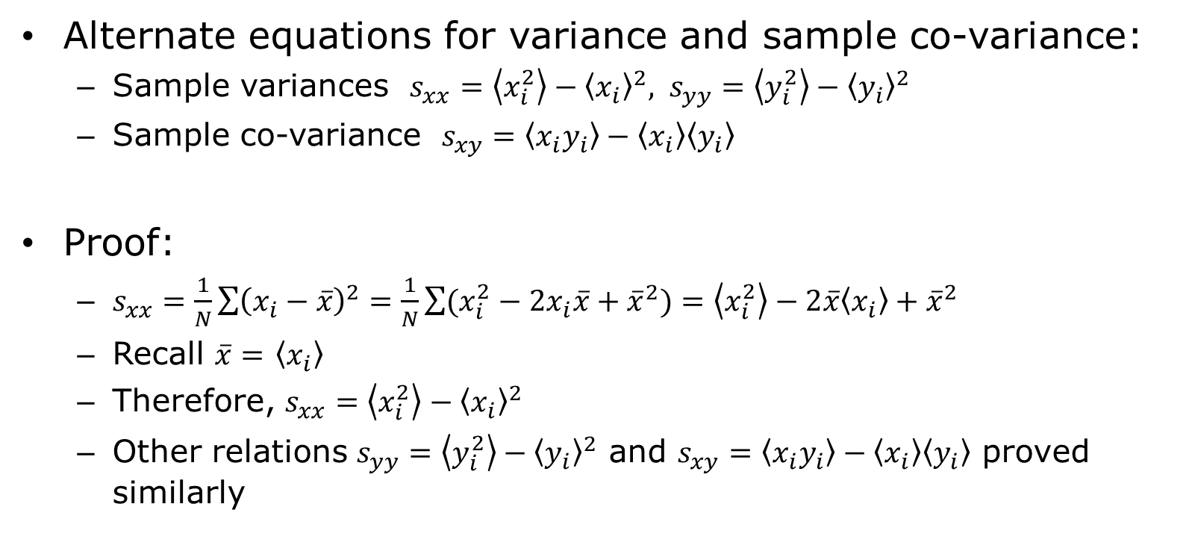
Alternate Equation for Variance
Alternate equations for variance and sample co-variance:
Sample variances $s_{xx}=\left\langle x_{i}^{2}\right\rangle −{\left\langle x_{i}\right\rangle }^{2}, s_{yy}=\left\langle y_{i}^{2}\right\rangle −{\left\langle y_{i}\right\rangle }^{2}$
Sample co-variance $s_{xy}=\left\langle x_{i}y_{i}\right\rangle −\left\langle x_{i}\right\rangle \left\langle y_{i}\right\rangle$
Proof:
$s_{xx}=\frac{1}{N}\sum{{\left(x_{i}−\overline{x}\right)}^{2}}=\frac{1}{N}\sum{(x_{i}^{2}−2x_{i}\overline{x}+{\overline{x}}^{2})}=\left\langle x_{i}^{2}\right\rangle −2\overline{x}\left\langle x_{i}\right\rangle +{\overline{x}}^{2}$
Recall $\overline{x}=$ $\left\langle x_{i}\right\rangle$
Therefore, $s_{xx}=\left\langle x_{i}^{2}\right\rangle −{\left\langle x_{i}\right\rangle }^{2}$
Other relations $s_{yy}=\left\langle y_{i}^{2}\right\rangle −{\left\langle y_{i}\right\rangle }^{2}$ and $s_{xy}=\left\langle x_{i}y_{i}\right\rangle −\left\langle x_{i}\right\rangle \left\langle y_{i}\right\rangle$ proved similarly

Slide 28
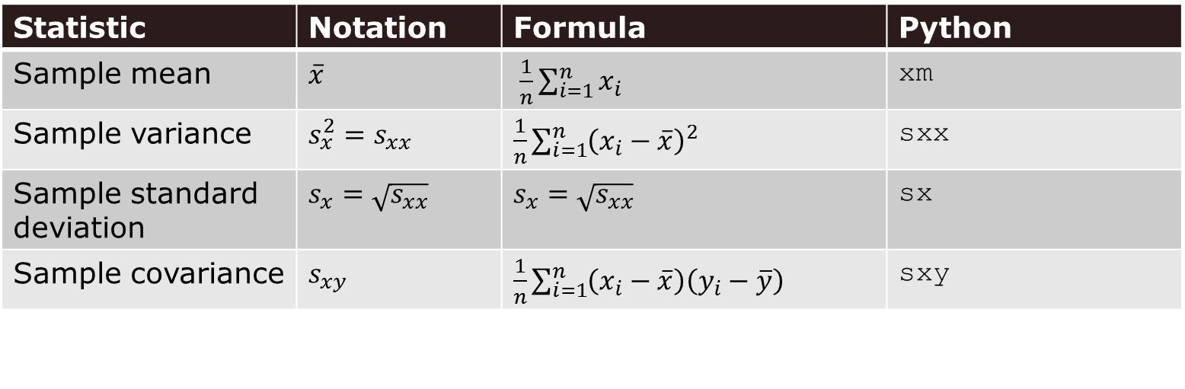
Notation
This class will use the following notation
We will try to be consistent
Note: Other texts use different notations
Statistic | Notation | Formula | Python
Sample mean | $\overline{x}$ | $\frac{1}{n}\sum_{i=1}^{n}{x_{i}}$ | xm
Sample variance | $s_{x}^{2}=s_{xx}$ | $\frac{1}{n}\sum_{i=1}^{n}{{\left(x_{i}−\overline{x}\right)}^{2}}$ | sxx
Sample standard deviation | $s_{x}=\sqrt{s_{xx}}$ | $s_{x}=\sqrt{s_{xx}}$ | sx
Sample covariance | $s_{xy}$ | $\frac{1}{n}\sum_{i=1}^{n}{\left(x_{i}−\overline{x}\right)\left(y_{i}−\overline{y}\right)}$ | sxy

Slide 29
Outline
Motivating Example: Predicting the mpg of a car
Linear Model
Least Squares Fit Problem
Sample Mean and Variance
LS Fit Solution
Assessing Goodness of Fit

Slide 30
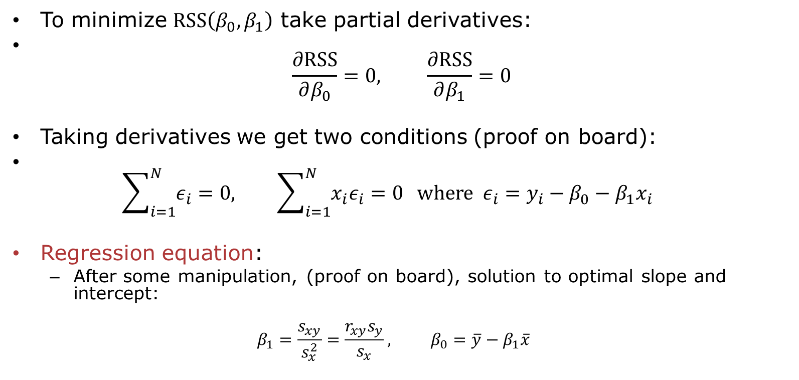
Minimizing RSS
To minimize $RSS\left(β_{0},β_{1}\right)$ take partial derivatives:
$\frac{∂\text{RSS}}{∂β_{0}}=0, \frac{∂\text{RSS}}{∂β_{1}}=0$
Taking derivatives we get two conditions (proof on board):
$\sum_{i=1}^{N}{ε_{i}}=0, \sum_{i=1}^{N}{{x_{i}ε}_{i}}=0 \text{where} ε_{i}=y_{i}−β_{0}−β_{1}x_{i}$
Regression equation:
After some manipulation, (proof on board), solution to optimal slope and intercept:
$$β_{1}=\frac{s_{xy}}{s_{x}^{2}}=\frac{r_{xy}s_{y}}{s_{x}}, β_{0}=\overline{y}−β_{1}\overline{x}$$

Slide 31
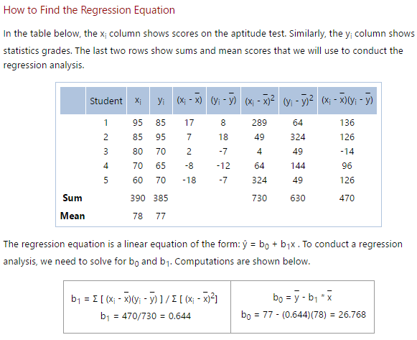
Simple Example
From: http://stattrek.com/regression/regression-example.aspx?Tutorial=AP
Very nice simple problems
Predict aptitude on one test from an earlier test
Draw a scatter plot and regression line

Slide 32
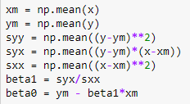
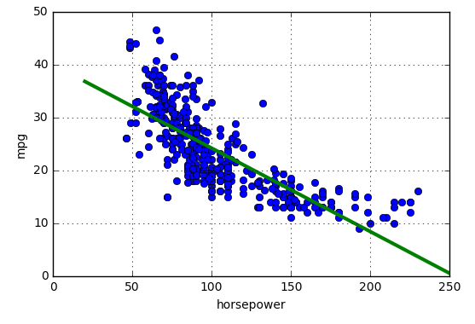
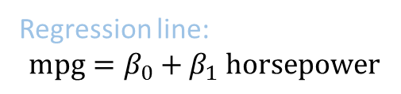
Auto Example
Python code
Regression line: $$\text{mpg}=β_{0}+β_{1} \text{horsepower}$$

Slide 33
Outline
Motivating Example: Predicting the mpg of a car
Linear Model
Least Squares Fit Problem
Sample Mean and Variance
LS Fit Solution
Assessing Goodness of Fit

Slide 34
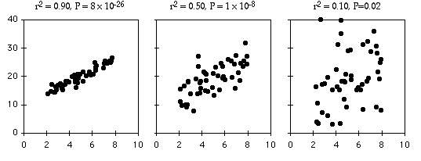
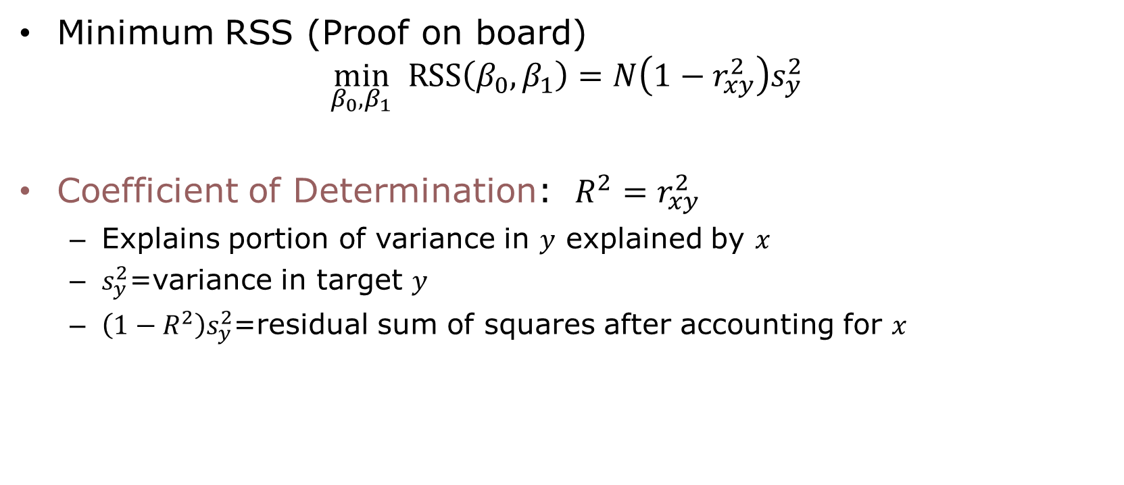
Minimum RSS
Minimum RSS (Proof on board) $\min_{β_{0},β_{1}} RSS\left(β_{0},β_{1}\right)=N\left(1−r_{xy}^{2}\right)s_{y}^{2}$
Coefficient of Determination: $R^{2}=r_{xy}^{2}$
Explains portion of variance in $y$ explained by $x$
$s_{y}^{2}$=variance in target $y$
$\left(1−R^{2}\right)s_{y}^{2}$=residual sum of squares after accounting for $x$

Slide 35
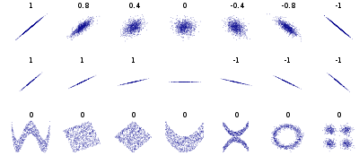
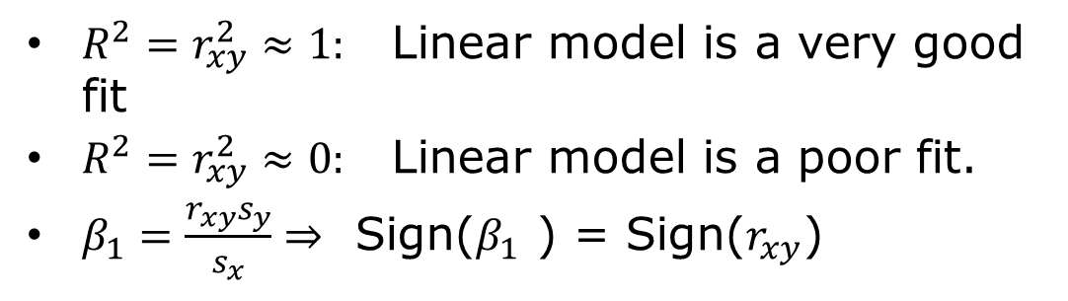
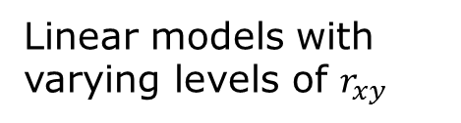
Visually seeing correlation
$R^{2}=r_{xy}^{2}≈1:$ Linear model is a very good fit
$R^{2}=r_{xy}^{2}≈0:$ Linear model is a poor fit.
$β_{1}=\frac{r_{xy}s_{y}}{s_{x}}⇒$ Sign($β_{1}$ ) = Sign($r_{xy}$)
Linear models with varying levels of $r_{xy}$
Very good fit
No linear relationship But, may be other relationships

Slide 36
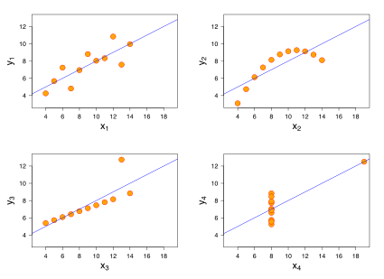
When the Error is Large…
Many sources of error for a linear model
Always good to visually inspect the scatter plot
Look for trends
Example to the left
All four data sets have same regression line
But, errors and their reasons are different
How would you describe these errors?

Slide 37
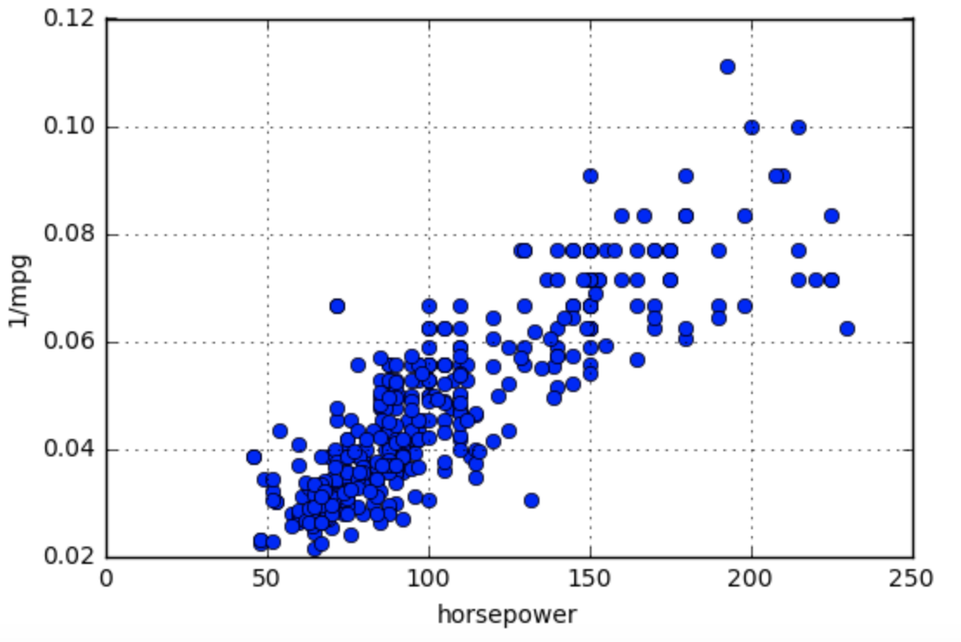
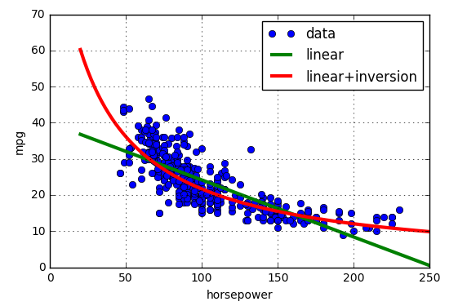
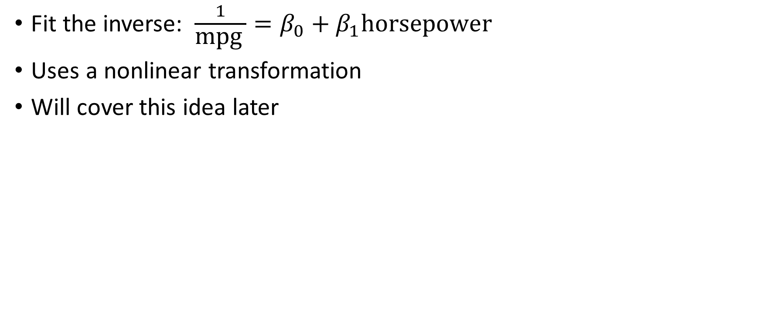
A Better Model for the Auto Example
Fit the inverse: $\frac{1}{\text{mpg} }=β_{0}+β_{1}\text{horsepower}$
Uses a nonlinear transformation
Will cover this idea later

